Slide 1
Word Study
Hillside School Curriculum Chat
October 24, 2014

Slide 2
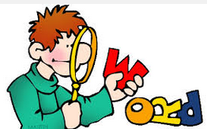
What is Word Study?
The study of how words work
relationships between vocabulary, phonics, spelling, derivational relationships (Greek and Latin roots) prefixes and suffixes
One component of a Balanced Literacy Approach
Transfers to Reading and Writing
Words Their Way: Word Study in Action
Hands on activities such as word sorting to build connections, discover similarities and differences among words and word patterns
Notes:
----- Meeting Notes (10/20/14 13:48) -----
So we are going to talk to today about word study and I'm going to ask you for this presentation to suspend all notions of what you believe spelling instruction is. At the end we can have a Q&A about traditional spelling instruction and the approach we are learning but I am going to be talking about what we call word study. One component of that is teaching accurate spelling. Accurate spelling is no the goal of word study it’s an outcome of it. Our goals for Word study is that we teach studets how words work and when you know how words work you are a proficient speller. and knowing how words work encompasses so much more of that. So traditional notions of spelling instruction on the back burner and let's all about hat we mean by word study.

Slide 3
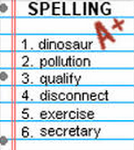
Why is Word Study Important?
The Friday Spellers- I know it on Friday. I’ve forgotten it on Monday (lack of application).
Best practices dictate a focus on correct spelling in context with patterns and meaning attached.
When correct phonetic vocabulary and spelling patterns are learned, that transfers to application in Reading and Writing (not necessarily when the correct spelling of certain words is learned).
Notes:
----- Meeting Notes (10/22/14 13:05) -----
Kids are having conversations about words and that is a really important thing.

Slide 4
Words Their Way Program Highlights
Hands on Approach
Follows a Continuum of spelling development
Comprehensive in covering all aspects of Word Study
The goal can not be simply can a student spell 10 words accurately but rather can he/she internalize phonetic awareness and make connections between words so that he/she can apply that knowledge independently and therefore spell accurately.
Differentiated Program
Notes:
----- Meeting Notes (10/22/14 13:07) -----
Talk about vocabulary as well
----- Meeting Notes (10/22/14 13:14) -----
our goal cant be stated that way because its too smple and narrow
our goal is broader

Slide 5
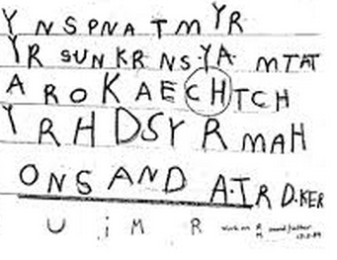
Developmental Stages
Emergent Spellers – Students spell their words with random marks, representational drawings, mock linear or letters like writing, random letters and numbers
Notes:
The first thing we want to do is to see what stage each student is in as a word solver
----- Meeting Notes (10/22/14 13:14) -----
so we talked about words their way drawing on esearch about developmental stages of spelling development so i thought it would be importnat to shwo you what thsoe stages are.

Slide 6
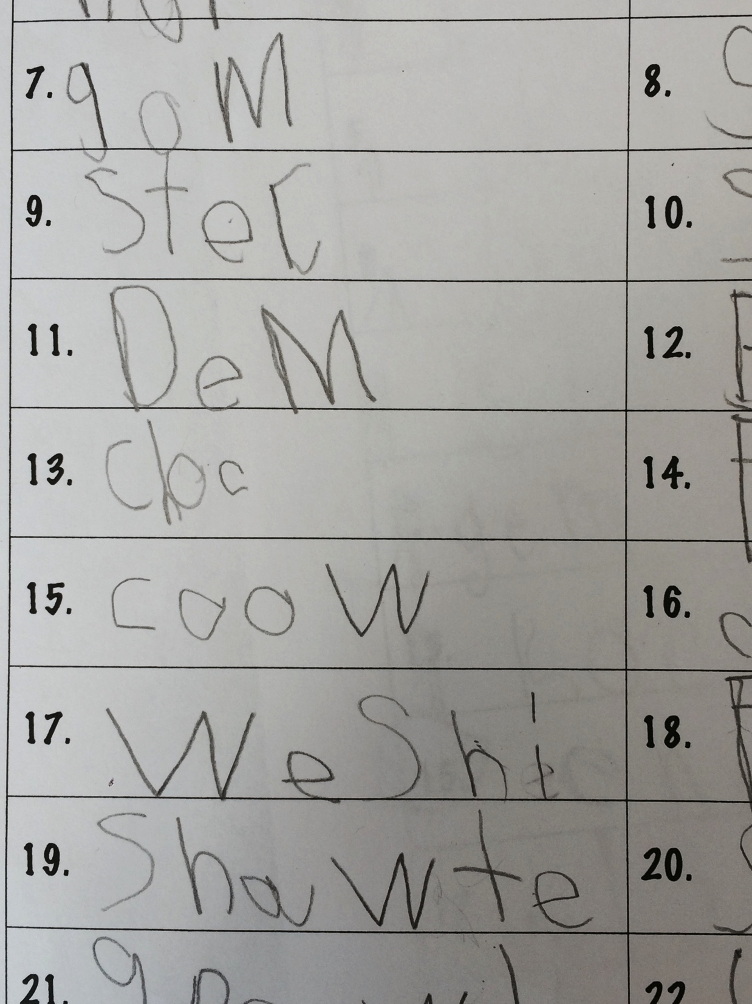
Developmental Stages
Letter Name Spellers: Students generally spell words with initial and final consonants and some vowels

Slide 7
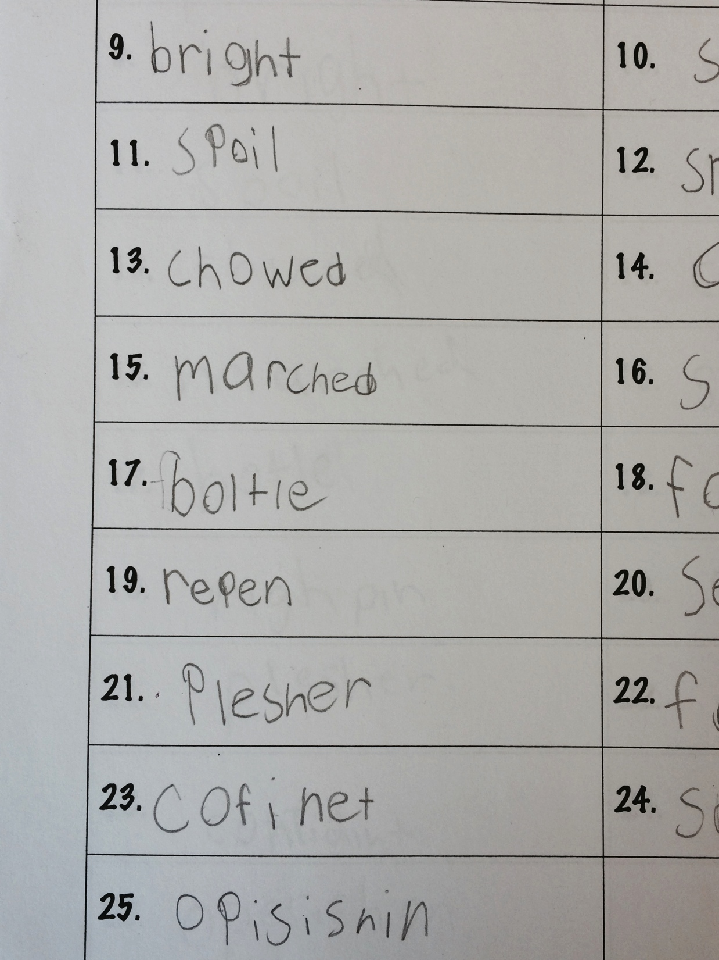
Developmental Stages
Within Word Spellers – Students spell their words with initial and final consonants and with some blends and diagraphs. In addition, they use some long and short vowel combinations.

Slide 8
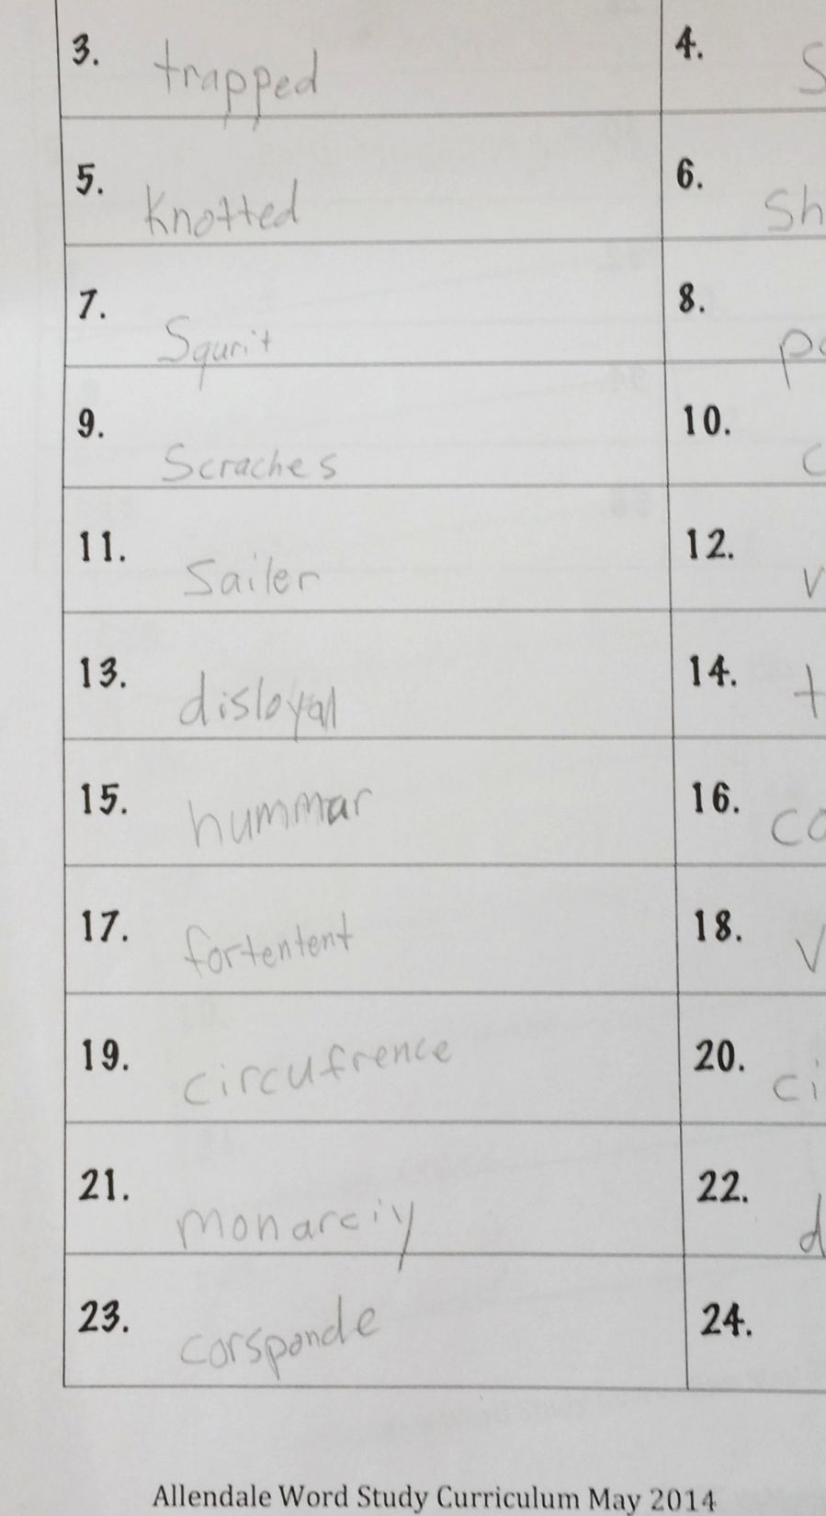
Developmental Stages
Syllables and Affixes Spellers – Students are able to spell some words that include consonant doubling, common suffixes and past tense endings.

Slide 9
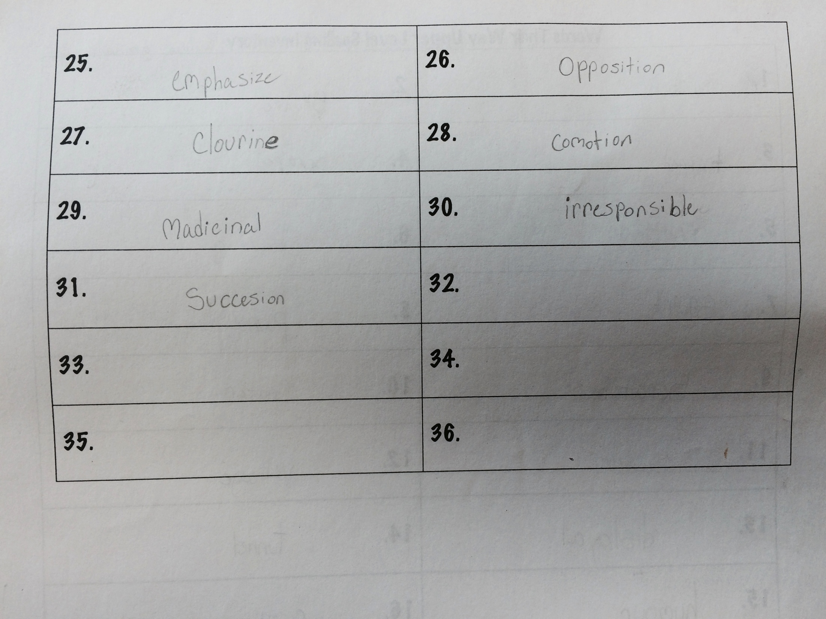
Developmental Stages
Derivational Relationships – Students begin learning internal morphology in syllables (bases and roots) as well as prefixes.

Slide 10
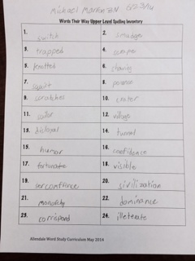
Determining a Student’s Spelling Stage
Assessing using the Words Their Way Spelling Inventory
Notes:
So to assess the word stage we use this spelling inventory

Slide 11
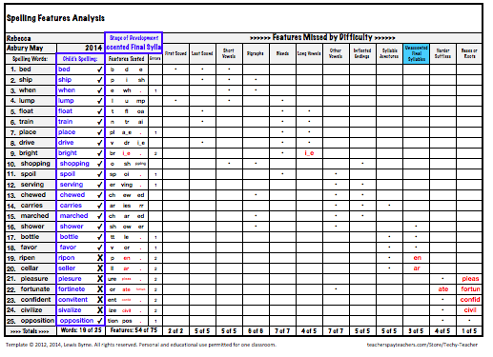
Determining a Student’s Spelling Stage
Assessment composite
Notes:
After scoring it (we enter it into a program that helps us with the scoring) we take a look at the results. Please note we are not looking to see how many words a student spelled correctly rather we are looking at what that child knows about words, letters, sounds, meaning etc. And this is why I want you to suspend what you think of as a spelling test. This is not a spelling pre-test this is a sophisticated assessment used to give teachers a plethora of information that is going to inform what they need to teach so students can continue to move along the continuum and across stages of spelling development.

Slide 12
Words Study and Word Lists
Word lists are designed for students to investigate a concept not exclusively for the goal of memorizing how to spell a word.
Assessment is on the concept and not the spelling so words that were not on a list will show up on an assessment.
Research is conclusive in finding that knowledge of how words work, of spelling concepts, and of word meaning leads to accurate spelling.
A word list may appear “easy” in terms of spelling but the concept behind it might be quite sophisticated.

Slide 13
Word Study in the Classroom
The Assessment Composite allows us to group students for instruction.
The program allows for 2 direct instruction days, 4 exploration days, 1 high frequency word practice days.

Slide 14
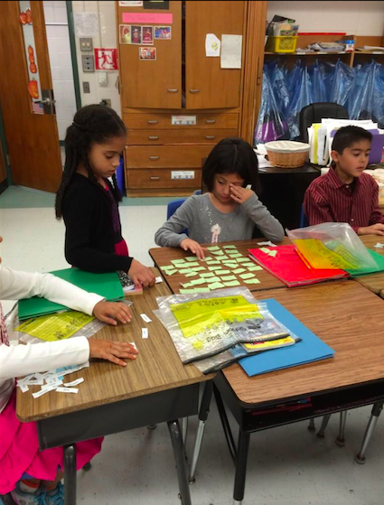
Word Study in the Classroom
Students work with words.
We want to guide self discovery.
We want to build deep connections.

Slide 15
Word Study in the Classroom
Students work with words.
We want to guide self discovery.
We want to build deep connections.
Concept Sort – Long a and short a

Slide 16
Word Study in the Classroom
Students work with words.
We want to guide self discovery.
We want to build deep connections.
Oddballs

Slide 17
Word Study in the Classroom
Sorting by initial sound

Slide 18
Word Study in the Classroom
Students work with words.
We want to guide self discovery.
We want to build deep connections.

Slide 19
Word Study in the Classroom
Speed Sort

Slide 20
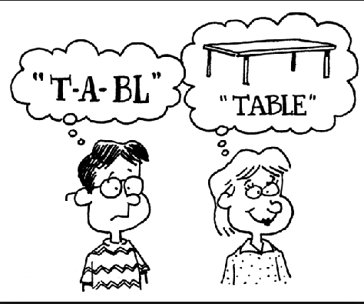
Words Their Way and Training Long Term Memory
Brain Research suggests we gain long term memory when we:
are actively engaged
manipulate ideas and objects
use language to clarify and cement our learning
interact with peers in directed conversations

Slide 21
Direct Instruction
Teaching Phonics and Spelling

Slide 22
Articulating Word Concepts
Learning about Plurals

Slide 23
Say it Spell it

Slide 24
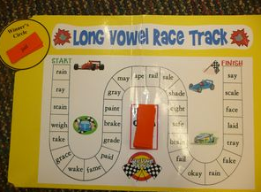
Games
Reinforce Word Concepts
Multiple exposures and opportunities to work with word lists.

Slide 25
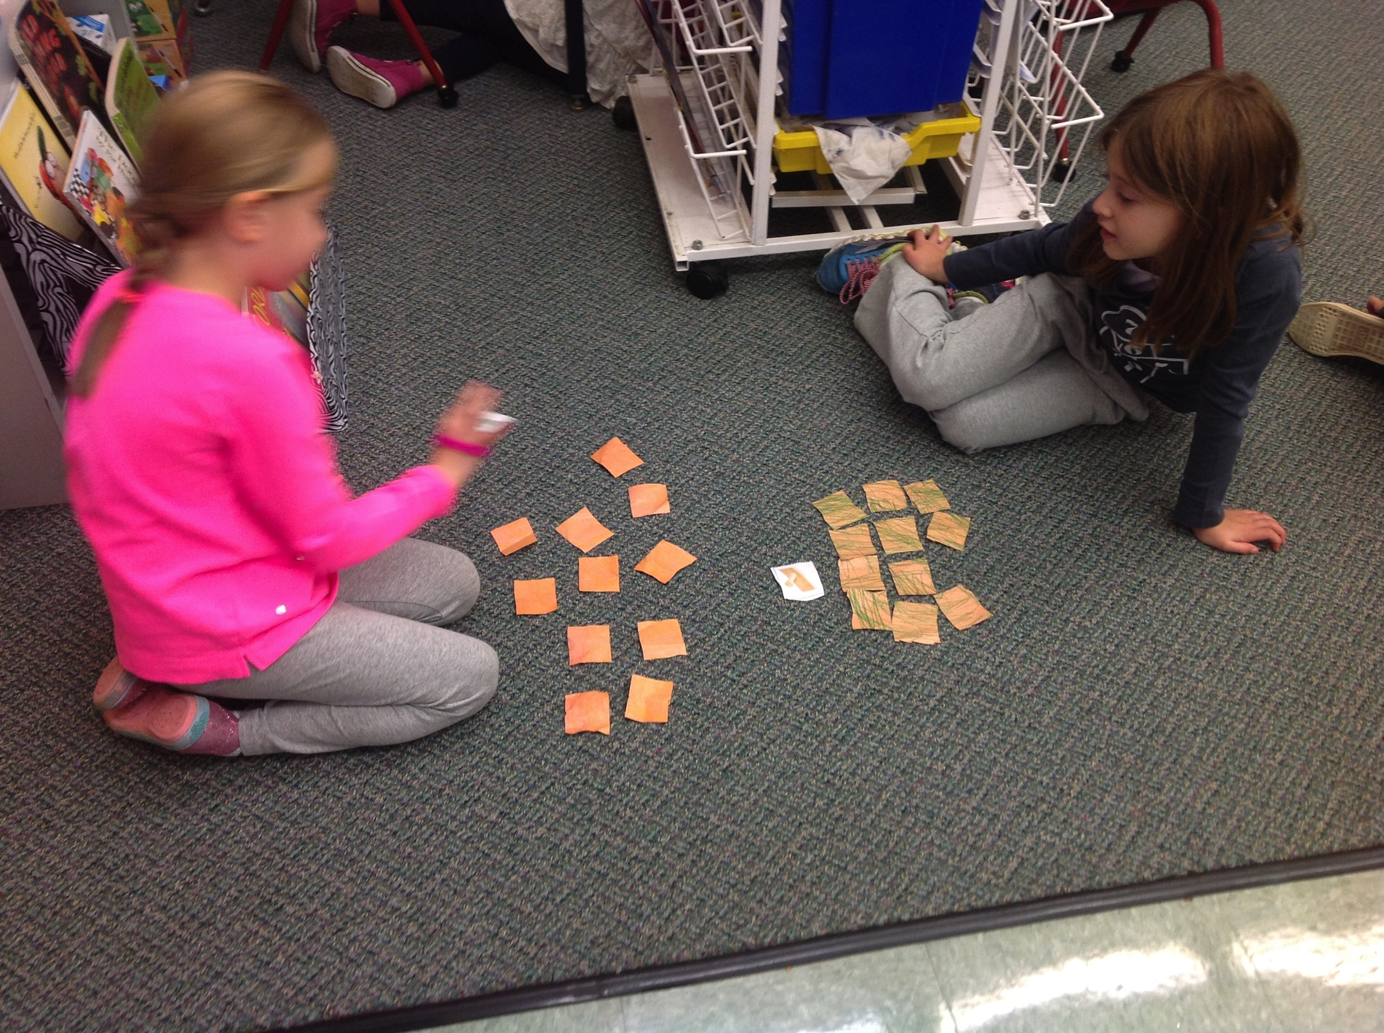
Games
Memory
Multiple exposures and opportunities to work with word lists.
Memory

Slide 26
Building Vocabulary
Direct Instruction

Slide 27
Building Vocabulary
Independent Practice
Guess my category

Slide 28
A Word Study Cycle in A Glance
Day 1: Teaching Day - Vocabulary Lesson
Day 2: Guess my Category (Vocabulary Activity)
Day 3: Teaching Day – Phonics Lesson
Day 4: Open Sort “Guess my rule”
Day 5: Closed Sort
Day 6: High Frequency Words Practice
Day 7: Closed Sort/Assessment

Slide 29
Managing Groups – Work Boards

Slide 30
Assessing Progress
Traditional spelling test
Closed sort
Adding new words to the closed sort (transfer)

Slide 31
Assessing Progress

Slide 32
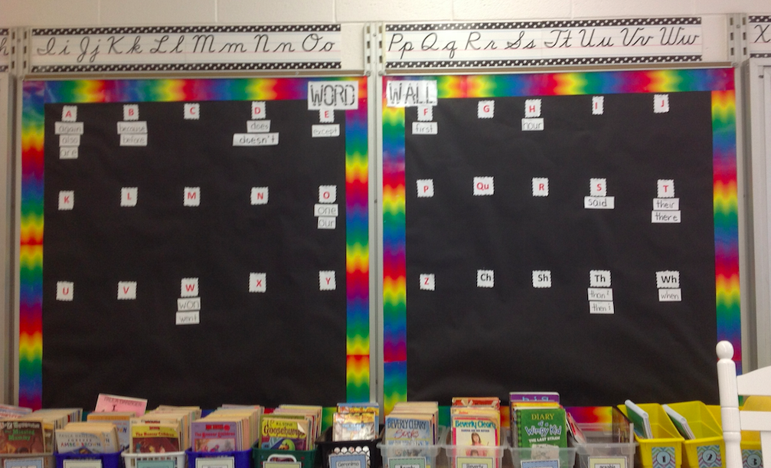
What happens with the words that don’t follow a pattern?
Practicing High Frequency Words - words most commonly used in the English language.
Word Wall
Look Say Cover Write Check
Training Visual Memory
Notes:
Example said or people

Slide 33
Supporting Word Study at Home
Spelling City
When helping your child spell a word, make connections between words, build on what they know to help them solve what they don’t know.
Play word games like Word Yahtzee, Scrabble, Boggle, Word Searches.

